Slide 1
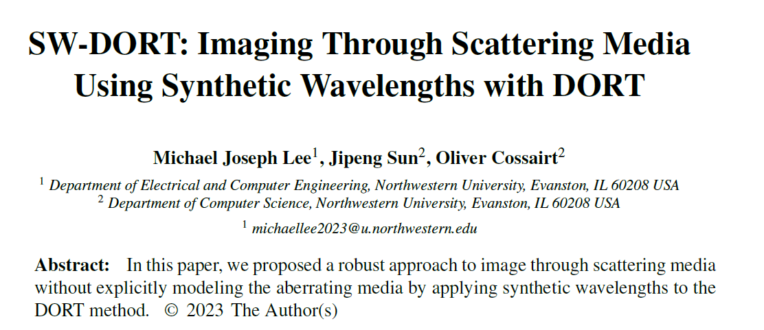

COSI 2023 – Conference Paper
Notes:
[Do not say anything]

Slide 2

SW-DORT: Imaging Through Scattering Media Using Synthetic Wavelengths with DORT
COSI 2023
Notes:
Hello. My name is Michael Lee and I shall be presenting on a technique for imaging small, discrete scatterers through aberrating media.

Slide 3
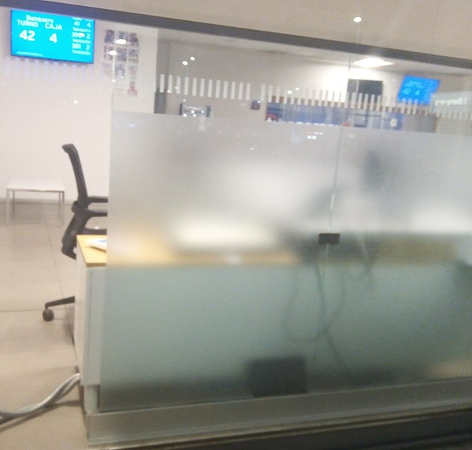
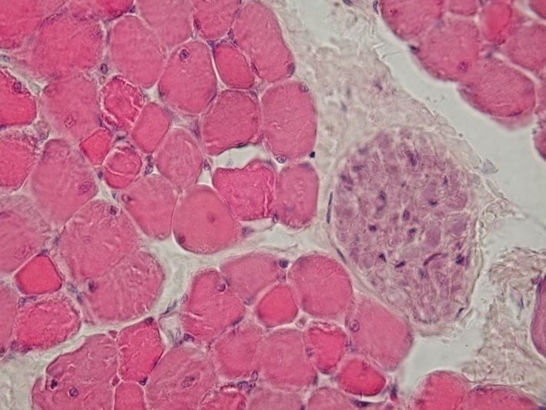
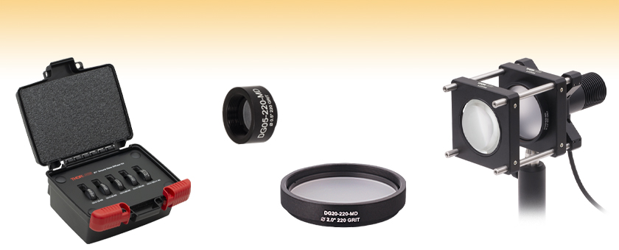
General Goal
Image through aberrating media
Want to do this without needing an explicit model for the aberrating media
***
*
**
Tissue
Optical Diffuser
Frosted Glass
*Image Source: https://commons.wikimedia.org/wiki/File:Skeletal_muscle_-_cross_section,_nerve_bundle.jpg
**Image Source: https://www.thorlabs.com/Images/GuideImages/6905_GGDiffusers_5.jpg
***Image Source: https://commons.wikimedia.org/wiki/File:Translucent_Glass.jpg
Notes:
Imaging through aberrating media is a difficult, yet useful task. For example, one might want to see through bodily tissue or a pane of frosted glass. However, in those cases, light gets aberrated, potentially making it difficult to get clear images. It would be nice to be able to see through such aberrating media.
This presentation will present on a method called synthetic wavelength DORT, or SW-DORT for short. This method allows one to image small, discrete scatterers behind aberrating media. In this method, no explicit model for the aberrating medium is required.

Slide 4
Background
Notes:
First, some background will be presented.

Slide 5
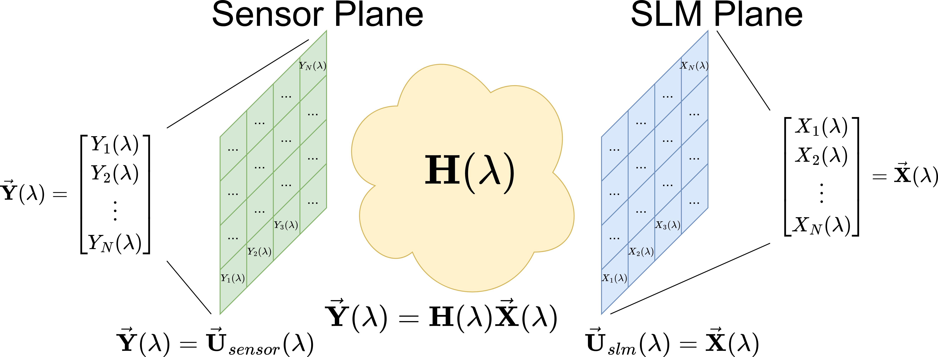
Transfer Matrices
Notes:
We will start off with some background on transfer matrices.
Transfer matrices relate a set of input signals to a set of output signals in the frequency domain. Each output signal can be expressed as a linear combination of the input signals. In our particular case, the input signals will be derived from the output of a spatial light modulator, or SLM for short. The output signals will be derived from the complex field incident on a camera sensor. Thus, the transfer matrix relates the output of an SLM to the input to a camera sensor.
Note that in the diagram on the slide, light goes from right to left, starting at the SLM plane and ending at the sensor plane.

Slide 6
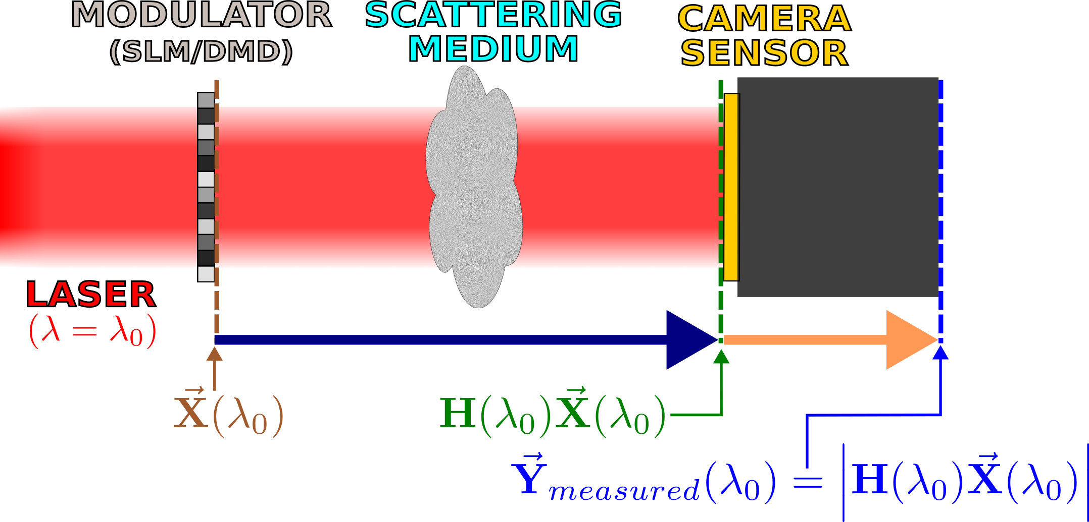
Transfer Matrix Measurement Process (For The Optical Regime)
Interferometric method in [1]
Computational optics-based method in [2] and [3]
Simplified Setup
[1] Boccara, and S. Gigan, “Measuring the transmission matrix in optics: An
approach to the study and control of light propagation in disordered media,”
Physical Review Letters, vol. 104, no. 10, 2010.
[2] C. A. Metzler, M. K. Sharma, S. Nagesh, R. G. Baraniuk, O. Cossairt, and A.
Veeraraghavan, “Coherent inverse scattering via transmission matrices:
Efficient Phase Retrieval Algorithms and a public dataset,” 2017 IEEE
International Conference on Computational Photography (ICCP), 2017.
[3] M. K. Sharma, C. A. Metzler, S. Nagesh, R. G. Baraniuk, O. Cossairt, and A.
Veeraraghavan, “Inverse scattering via transmission matrices: Broadband
illumination and fast phase retrieval algorithms,” IEEE Transactions on
Computational Imaging, vol. 6, p. 95–108, 2020.
Notes:
In acoustics, radio frequency, i.e. RF, and microwaves, one can directly sample waveforms in time. This makes the process of measuring transfer matrices much simpler.
However, in optics, it is more difficult to measure transfer matrices. One cannot directly sample waveforms at optical frequencies. Moreover, typical camera sensors do not measure phase information---they only measure intensity.
So how does one measure transfer matrices in the optical regime?
One can use interferometry to measure a transfer matrix, like in source [1]. However, interferometric methods can be sensitive to vibrations and they require a reference to be used.
Another method for measuring the transfer matrix is given in sources [2] and [3]. This method uses computational optics rather than interferometry. A simplified setup for the method is shown on this slide. The method involves projecting patterns onto an SLM, measuring the resulting intensity images on the camera sensor, and then performing phase recovery.

Slide 7
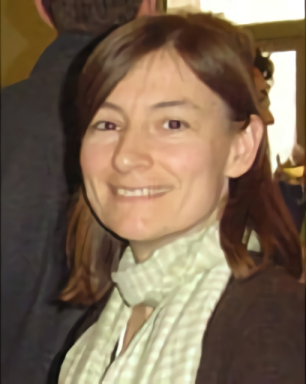
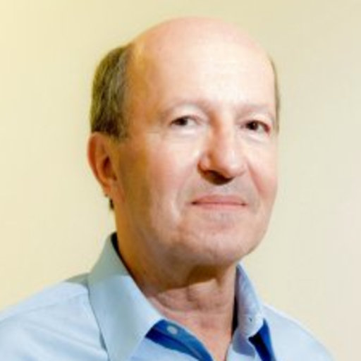
DORT Background
DORT – French acronym that means “decomposition of the time-reversal operator”
Arose from the study of acoustic time-reversal mirrors
Invented by Claire Prada in the 1990s
Claire Prada
Mathias Fink
(Claire Prada’s Advisor)
Notes:
Now for some background on DORT.
DORT is a French acronym that means “decomposition of the time-reversal operator”. The name, while accurate, does not tell one much about how DORT is actually performed. No explicit time-reversal is performed when performing DORT.
The DORT technique can be used to image scatterers of waves and to selectively focus on scatterers.

Slide 8


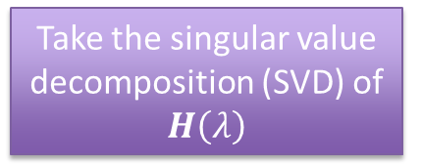
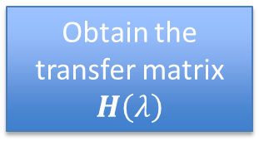

Performing DORT
Results of DORT
DORT
Left-singular vectors
$$\left\{u_{i}\left(λ\right)\right\}$$
Obtain the transfer matrix $H\left(λ\right)$
Take the singular value decomposition (SVD) of $H\left(λ\right)$
Right-singular vectors
$$\left\{v_{i}\left(λ\right)\right\}$$
Singular values
$$\left\{σ_{i}\left(λ\right)\right\}$$
Notes:
In order to perform DORT, one must first obtain the transfer matrix $H\left(λ\right)$. DORT is then performed by taking the singular value decomposition, or SVD, of the transfer matrix $H\left(λ\right)$. This gives a set of right-singular vectors, left-singular vectors, and singular values.

Slide 9
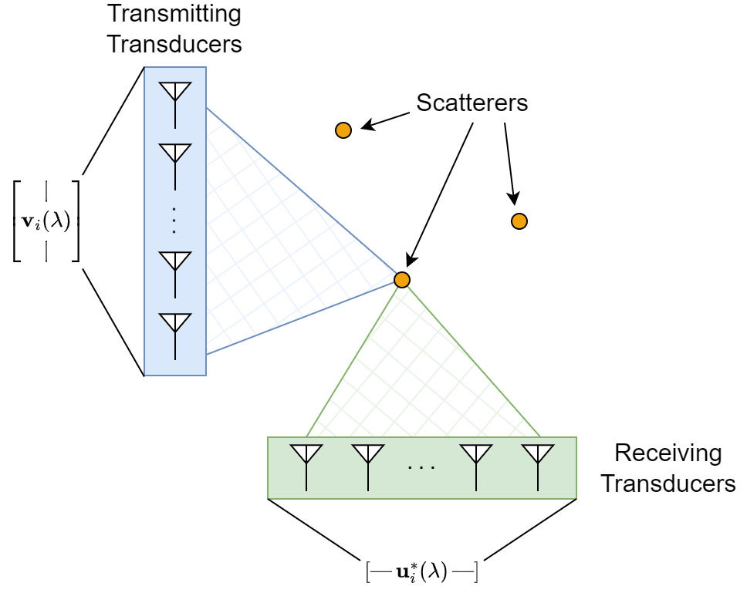
Singular Vectors and Singular Values from DORT
Singular vectors from DORT tell one how to beamform to focus on individual scatterers*
Components of singular vectors are used to determine amplitudes and phases of individual elements
Singular values relate to scattering strength*,**
*Under certain conditions, i.e. “ideally-resolved” scatterers; see [4].
**Roughly speaking; see [4].
[4] M. Fink and C. Prada, Detection and Imaging in Complex Media with the D.O.R.T. Method, pp. 107–134.
Springer Berlin Heidelberg, 2002. From the book titled Imaging of Complex Media with acoustic and seismic waves.
Notes:
Under certain conditions, namely “ideally-resolved” scatterers, the singular vectors tell one how to beamform to focus on individual scatterers. One can backpropagate singular vectors to selectively focus on scatterers. Under those same conditions, the singular values are related to the scattering strength of each scatterer.
The right-singular vectors can be backpropagated from the transmitting transducers to selectively focus using the transmitting transducers. The complex conjugates of the left-singular vectors can be backpropagated from the receiving transducers to selectively focus using the receiving transducers.
One can backpropagate these selectively focusing signals and observe the resulting field patterns. For each pattern from a backpropagated singular vector, one will ideally see the fields get intense around a single scatterer’s location.

Slide 10
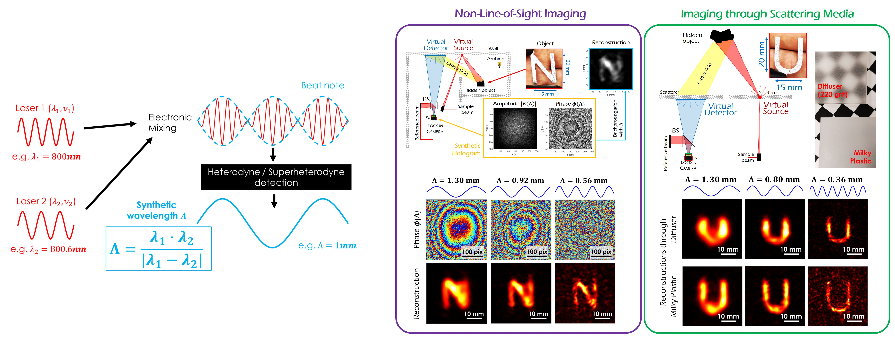
Synthetic Wavelengths – Main Idea
Heterodyne/mix two fields at nearby wavelengths to obtain a longer effective wavelength
Image source: https://3dim.northwestern.edu/project/swh/
Notes:
Now for some background on synthetic wavelengths.
The main idea of synthetic wavelengths is to heterodyne or mix two fields at nearby wavelengths to obtain a longer effective wavelength. This longer wavelength is more resilient to path length aberrations.

Slide 11
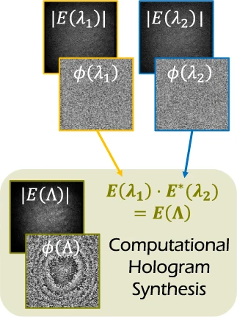
Generating Synthetic Fields
Image Credit
Image adapted from [5]
Can be backpropagated,
e.g. like in [5]
[5] F. Willomitzer, P. V. Rangarajan, F. Li, M. M. Balaji, M. P.
Christensen, and O. Cossairt, “Fast non-line-of-sight imaging
with high-resolution and wide field of view using synthetic
wavelength holography,” Nature Communications, vol. 12,
p. 6647, Nov 2021.
Notes:
One can generate a synthetic field by multiplying one complex field at one wavelength by the complex conjugate of another field at a nearby wavelength. This creates a synthetic field. In certain cases, like the case in source [5], this synthetic field can be backpropagated at the synthetic wavelength to form images.

Slide 12
More Information on Synthetic Wavelengths
[5] F. Willomitzer, P. V. Rangarajan, F. Li, M. M. Balaji, M. P. Christensen, and O. Cossairt, “Fast non-line-of-sight imaging with high-resolution and wide field of view using synthetic wavelength holography,” Nature Communications, vol. 12, p. 6647, Nov 2021.
[6] Y. Wu, F. Li, F. Willomitzer, A. Veeraraghavan, and O. Cossairt, “WISHED: Wavefront imaging sensor with high resolution and depth ranging,” 2020 IEEE International Conference on Computational Photography (ICCP), 2020.
Notes:
There is a lot more to synthetic wavelengths than what I have presented. For more information on synthetic wavelengths, please see the sources shown on the slides.

Slide 13
Synthetic Wavelength DORT
SW-DORT
Notes:
Now that the background is done, I shall now describe some of the work that I have done.
The work I have done can be referred to as “synthetic wavelength DORT”, or “SW-DORT”.
Synthetic wavelength DORT combines DORT with synthetic wavelengths to perform imaging.

Slide 14
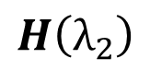
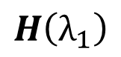
Synthetic Wavelength DORT Process
$$H\left(λ_{1}\right)$$
DORT
Derive fields from singular vectors
Generate synthetic field
$$H\left(λ_{2}\right)$$
Backpropagate synthetic field
Scatterer Image
Notes:
Synthetic wavelength DORT requires that one has the transfer matrix for two closely spaced wavelengths.
DORT is performed, yielding a set of singular vectors.
One takes a pair of singular vectors, and from those singular vectors, derives fields.
These fields are then used to derive a synthetic field.
The synthetic field is then backpropagated, and images are obtained.

Slide 15
Imaging Through Aberrating Media With Synthetic Wavelength DORT Simulation
Notes:
For a more concrete example of synthetic wavelength DORT, I shall describe a simulation that was done that uses synthetic wavelength DORT. In this simulation, small, discrete scatterers are imaged through an aberrating medium using synthetic wavelength DORT.

Slide 16
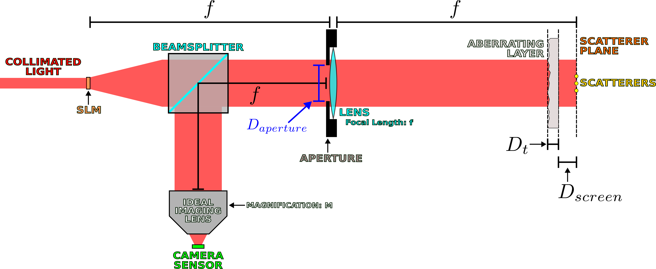
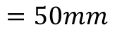
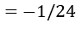
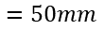
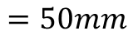
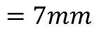
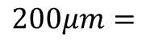
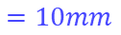
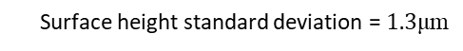
Simulated Setup
$$=50mm$$
$$=50mm$$
$$=50mm$$
$$=50mm$$
$$=10mm$$
$$200μm=$$
Surface height standard deviation = $1.3\text{μ}\text{m}$
$$=−1/24$$
$$=7mm$$
Scatterers are on the order of 0.01mm in diameter
Notes:
The simulated setup is essentially a Fourier transforming lens setup. The input, i.e. the output of a spatial light modulator, is located in the front focal plane, and the scatterers are located in the back focal plane. The scatterers are on the order of 0.01mm in diameter. Between the lens and scatterers is an aberrating layer that is 200 micrometers thick. That aberrating layer has a surface height standard deviation of 1.3 micrometers.
The transfer matrix relates the SLM output to the incident field on the camera sensor. This transfer matrix is obtained via simulation. Since everything here was done in simulation, both phase and amplitude could be measured, thus making it easier to measure the transfer matrix---there was no need to go through any of the methodologies given in sources [1] through [3] because phase could be directly measured in simulation.

Slide 17
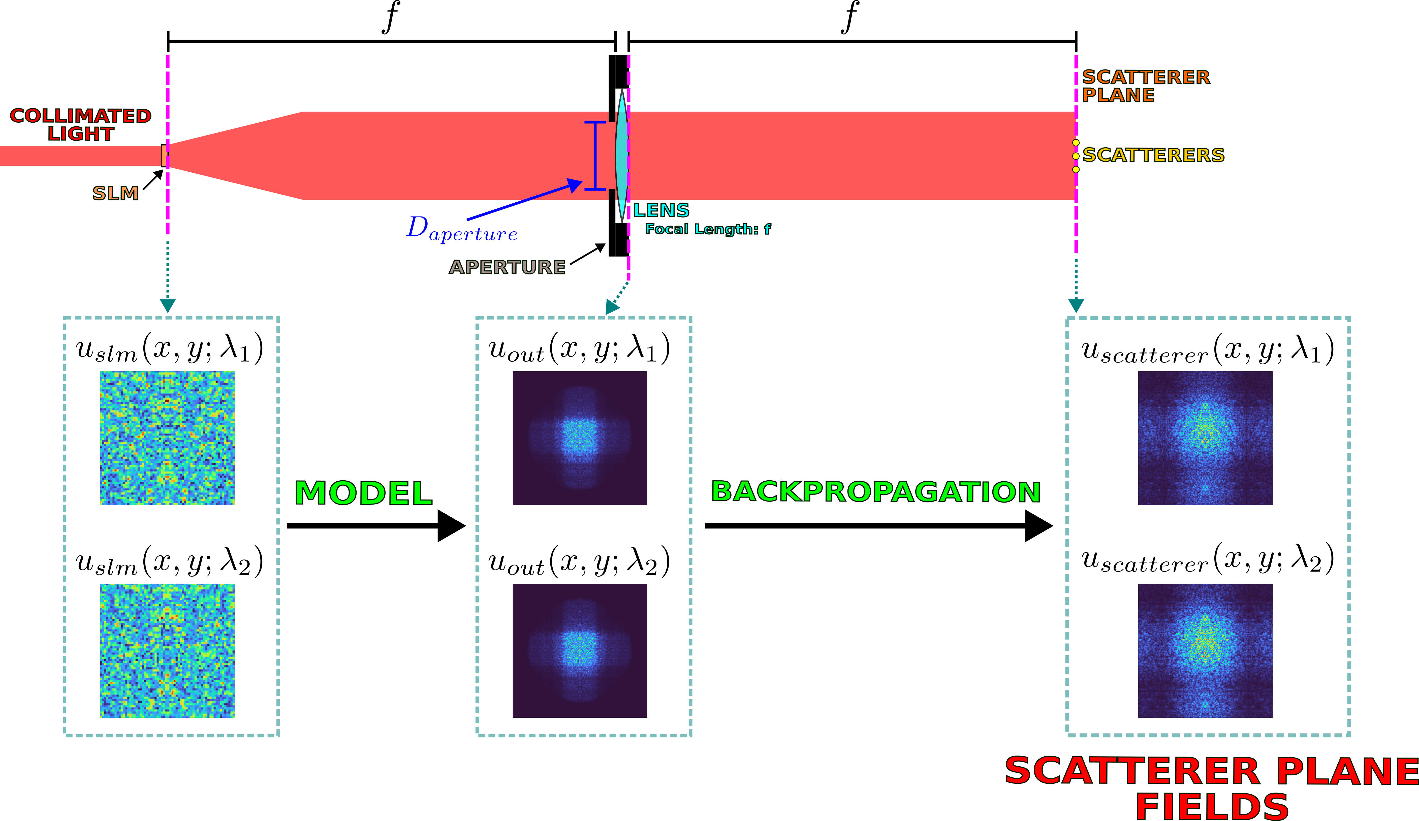
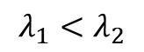
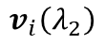
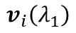
Backpropagation without Synthetic Wavelengths
$$λ_{1}<λ_{2}$$
$$v_{i}\left(λ_{1}\right)$$
$$v_{i}\left(λ_{2}\right)$$
Right-singular vectors
Notes:
Now, imagine that one wanted to use conventional DORT to image in this situation.
Also imagine that one does not explicitly know the aberrating medium, so it cannot be modeled during backpropagation.
Imagine that instead, one replaced the aberrating medium with free space.
One can derive SLM patterns from the right-singular vectors and project those patterns onto the SLM. One can then propagate through the model of the system, up until the output of the lens.
Then, one can backpropagate through free space to the scatterer plane to attempt to get images.

Slide 18
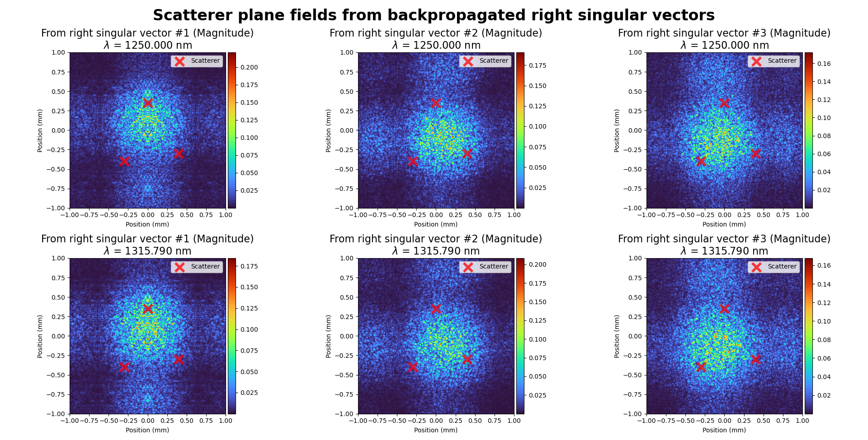
Results (Without Synthetic Wavelengths)
Notes:
These are the results of doing what was described on the previous slide. It can be seen that not modeling the aberrating layer, i.e. replacing the aberrating layer with free space, results in poor images. The fields are not focused on the scatterers and one cannot tell where the scatterers are from just looking at the fields.

Slide 19
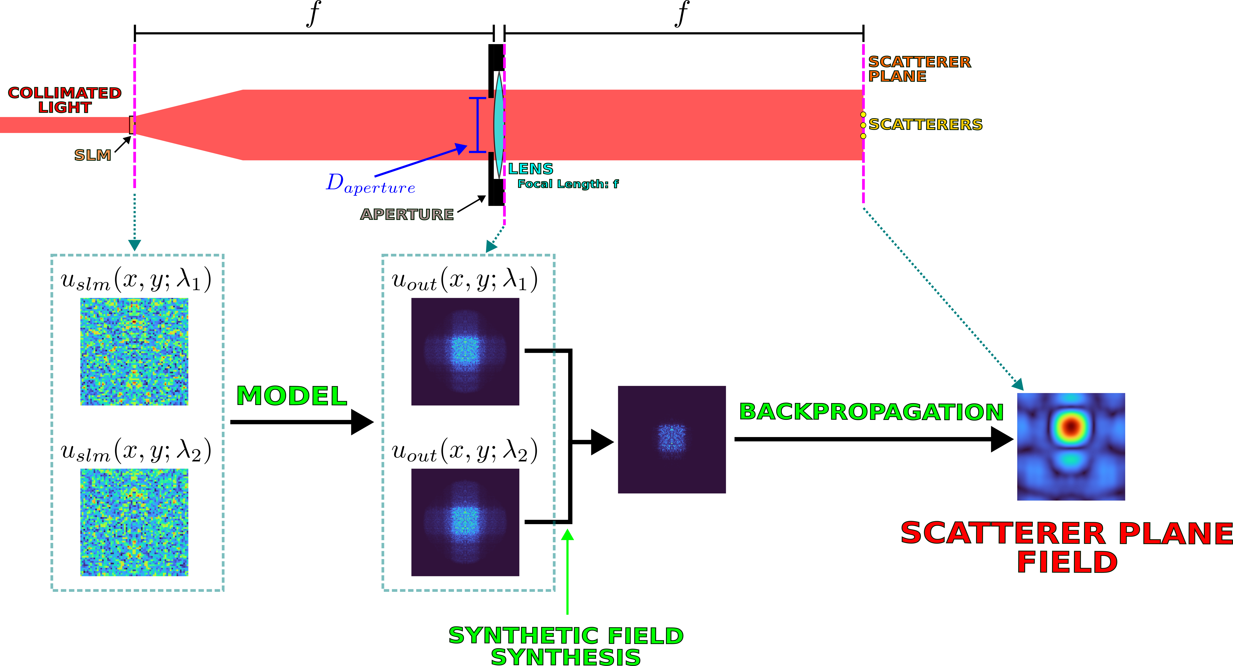
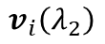
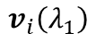
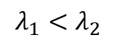
Backpropagation with Synthetic Wavelengths
$$λ_{1}<λ_{2}$$
$$v_{i}\left(λ_{1}\right)$$
$$v_{i}\left(λ_{2}\right)$$
$$u_{synth}\left(x,y;Λ\right)=u_{out}\left(x,y;λ_{1}\right) \text{⊙} u_{out}^{∗}\left(x,y;λ_{2}\right)$$
Right-singular vectors
Notes:
So how can one fix this? Well, one can again get the fields at the output of the lens. However, instead of backpropagating those fields, one can create a synthetic field using the formula for u_synth shown in the slide. In that formula, the dotted circle represents pointwise multiplication.
That synthetic field can be backpropagated at the synthetic wavelength through free space to the scatterer plane.

Slide 20
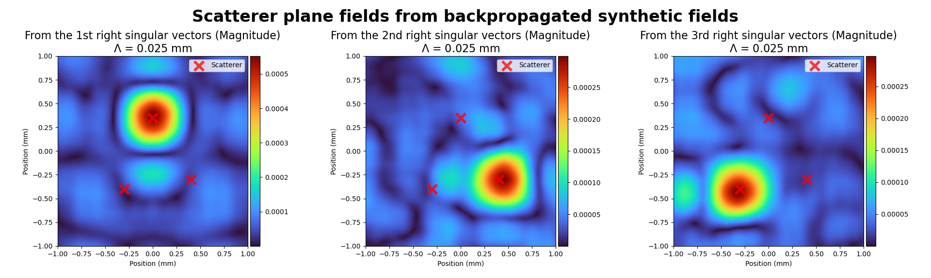
Results (With Synthetic Wavelengths)
Notes:
Doing this results in images of the scatterers. As one can see, the fields are focused around the locations of the scatterers.

Slide 21
Experiment Conclusions
Regular DORT – Fails
DORT + synthetic wavelengths – succeeds
Notes:
So, as one can see, regular DORT backpropagation fails to form images of scatterers when the aberrating layer is not modeled. However, combining DORT with synthetic wavelengths allows for backpropagation to form images of scatterers even without modeling the aberrating layer.

Slide 22
Conclusion
Promising results in simulation
Synthetic wavelength DORT can image small, discrete scatterers behind aberrating media?
No model for aberrating media required
Notes:
So how much can one conclude from this simulation? Admittedly, not too much since it is only simulation. A more convincing test would have been to do a real-life, physical experiment. Regardless, this simulation is a promising first step.
Ultimately, one can say that limited experimental evidence from simulation indicates that synthetic wavelength DORT may be able to be used to image small, discrete scatterers through aberrating media, without requiring an explicit model for the aberrating media.

Slide 23
References
[1] Boccara, and S. Gigan, “Measuring the transmission matrix in optics: An approach to the study and control of light propagation in disordered media,” Physical Review Letters, vol. 104, no. 10, 2010.
[2] C. A. Metzler, M. K. Sharma, S. Nagesh, R. G. Baraniuk, O. Cossairt, and A. Veeraraghavan, “Coherent inverse scattering via transmission matrices: Efficient Phase Retrieval Algorithms and a public dataset,” 2017 IEEE International Conference on Computational Photography (ICCP), 2017.
[3] M. K. Sharma, C. A. Metzler, S. Nagesh, R. G. Baraniuk, O. Cossairt, and A. Veeraraghavan, “Inverse scattering via transmission matrices: Broadband illumination and fast phase retrieval algorithms,” IEEE Transactions on Computational Imaging, vol. 6, p. 95–108, 2020.
[4] M. Fink and C. Prada, Detection and Imaging in Complex Media with the D.O.R.T. Method, pp. 107–134. Springer Berlin Heidelberg, 2002. From the book titled Imaging of Complex Media with acoustic and seismic waves.
[5] F. Willomitzer, P. V. Rangarajan, F. Li, M. M. Balaji, M. P. Christensen, and O. Cossairt, “Fast non-line-of-sight imaging with high-resolution and wide field of view using synthetic wavelength holography,” Nature Communications, vol. 12, p. 6647, Nov 2021.
[6] Y. Wu, F. Li, F. Willomitzer, A. Veeraraghavan, and O. Cossairt, “WISHED: Wavefront imaging sensor with high resolution and depth ranging,” 2020 IEEE International Conference on Computational Photography (ICCP), 2020.
Notes:
Here are the references.

Slide 24
COSI 2023 – Conference Paper
Notes:
And this is the conference paper that is associated with this presentation.

